Slide 1
Stock Market prediction
(DSCI 6007-02 Distributed and Scalable Data Engineering)
Group - 9

Slide 2

Team Member
BAHAREH ARGHAVANI NOBAR
DEVNATH REDDY MOTATI
VIJITHA PYETA GOUDA KAKE
NAGA VENKATA SAI TEJA KEERTY

Slide 3
Stock prediction is important for several reasons:
The stock market is a complex system influenced by various factors such as economic indicators, company news, and global events.
Predicting the stock market is a challenging task, but machine learning techniques can help us make better predictions.
In this presentation, we will demonstrate how we can use machine learning to predict stock prices using Python and the scikit-learn library

Slide 4
Data Sources
Leveraging the Advantages of yfinance Library as a Data Source for Stock Market Prediction
Simple and Convenient: The yfinance library is a Python library that provides a simple and convenient interface for downloading historical data from Yahoo Finance. The library allows users to easily specify the tickers, dates, and intervals of the data they want to download, and it automatically handles the authentication and formatting of the data.
High-Quality Data: The yfinance library retrieves data directly from Yahoo Finance, which is a reliable and high-quality source of financial data. The library provides access to a wide range of financial data, including stock prices, dividends, splits, and financial statements, which can be used for stock market prediction and analysis.
Customizable: The yfinance library is highly customizable and allows users to specify a wide range of parameters for downloading and formatting the data. Users can specify the frequency of the data (daily, weekly, monthly, etc.), the time zone, and the format of the output data. This level of customization makes it easier for users to integrate the data into their analysis pipeline and tailor it to their specific needs.

Slide 5
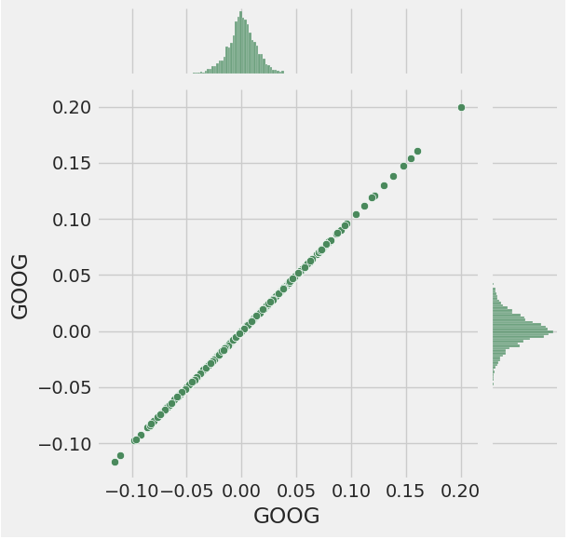
Feature Engineering
Identify relevant features for stock market prediction, such as technical indicators, fundamental ratios, and market sentiment data.
Use techniques like correlation analysis, feature importance scores, and domain knowledge to select the most relevant features.
Apply feature selection techniques, such as principal component analysis (PCA), to reduce the dimensionality of the feature space while retaining the most important information.

Slide 6
Model Selection
The machine learning model used in the notebook is a Support Vector Machine (SVM) for classification, which predicts whether the closing price of a stock will increase or decrease based on input features.
SVM is a popular and powerful machine learning algorithm that can be used for both classification and regression tasks.
The scikit-learn library's SVM implementation was used in the notebook, which is a widely used open-source machine learning library in Python

Slide 7
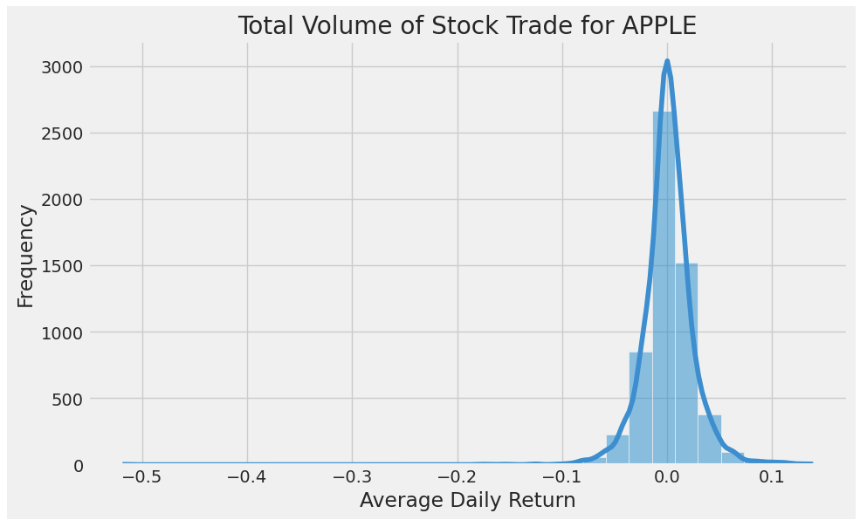
Model Evaluation
Cross-validation is used to evaluate the SVM model in the notebook.
The accuracy score is computed as the average of the accuracy scores obtained on each fold.
Other evaluation metrics such as precision, recall, and F1 score can also be used to evaluate the performance of classification models.

Slide 8
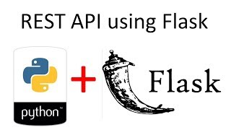

Deployment
After finalizing the model, a RESTful API or web service was created using a suitable framework like Flask.
The purpose of this API is to serve as the interface between the users and the LSTM model, allowing users to send requests to the model and receive predictions back.
Once the API was created, it will need to be deployed on a cloud platform such as AWS to ensure accessibility and scalability.

Slide 9
DEMO

Slide 10
Conclusion
Distributed machine learning can help us make better predictions in the stock market by leveraging the power of parallel computing.
Our approach demonstrated how we can use technical indicators and lagged features to improve the prediction performance in a distributed environment.
The results showed that distributed gradient boosting outperformed other models in predicting stock prices for AAPL.
However, the prediction accuracy is subject to various factors, and investors should use caution when making investment decisions based on machine learning predictions.

Slide 11
Resources
Github link :Https://GitHub.com/orgs/DSCI-6007-02-group-09
Python notebook: https://colab.research.google.com/drive/1MWrzg5yY1B5guLK0VthcZAN1NqNE0lRr?usp=sharing

